Slide 1
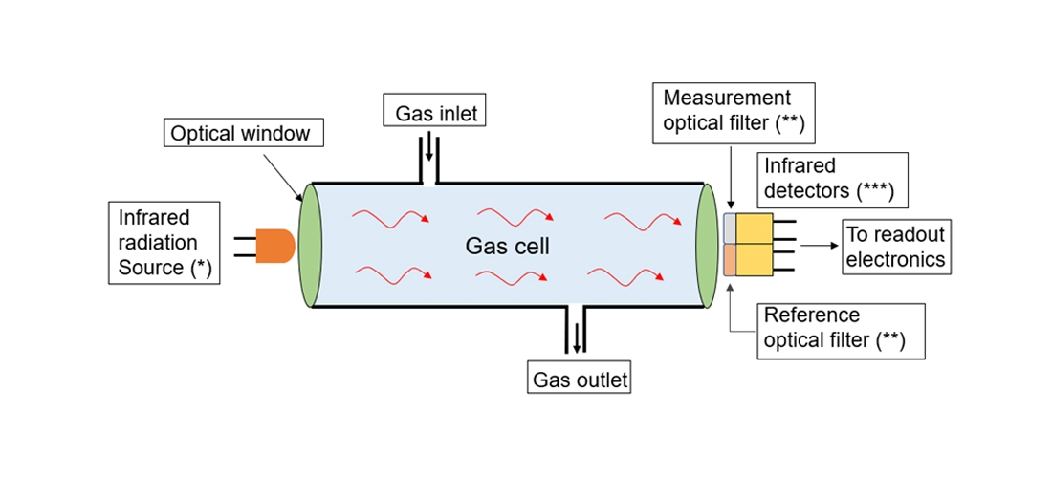
NDIR Gas Sensor
Rishav Pandey
Research Intern @ CSIR-CEERI
Senior Undergraduate @ Jabalpur Engineering College

Slide 2
What is NDIR Gas Sensor?
NDIR is an industry term for "non dispersive infrared", and is the most common type of sensor used to measure carbon dioxide, or CO2.
It is called as Non- Dispersive because the IR light which passes through the gas chamber is not pre-filtered.
The operating principle of basic NDIR System is somewhat related to Beer-Lambert Law.

Slide 3
Beer-Lambert Law
Lambert’s Law:
When a beam of monochromatic light passes through an absorbing medium then its intensity decreases exponentially as the length of the absorbing medium increases.
I=I₀ e^{-kl} or, A ∝ l
Beer’s Law:
When a beam of monochromatic light passes through an absorbing medium then its intensity decreases exponentially as the concentration of the absorbing medium increases.
I=I₀ e^{-k’c} or, A ∝ c

Slide 4
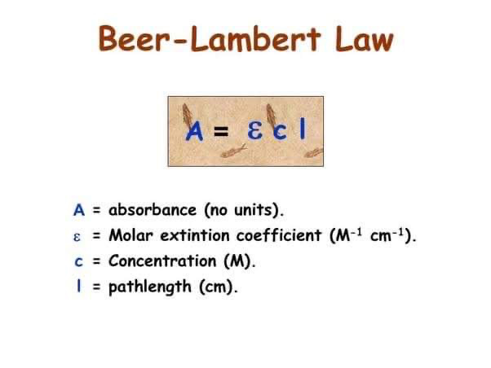
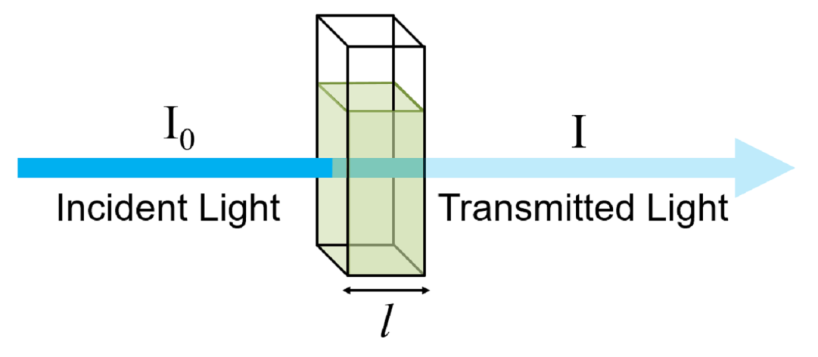
Continued….
When both the laws are combined together we get Beer Lambert Law which is given by:

Slide 5
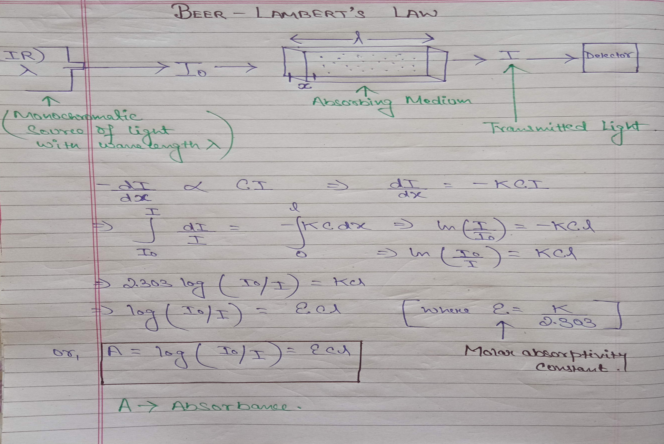
Continued….

Slide 6
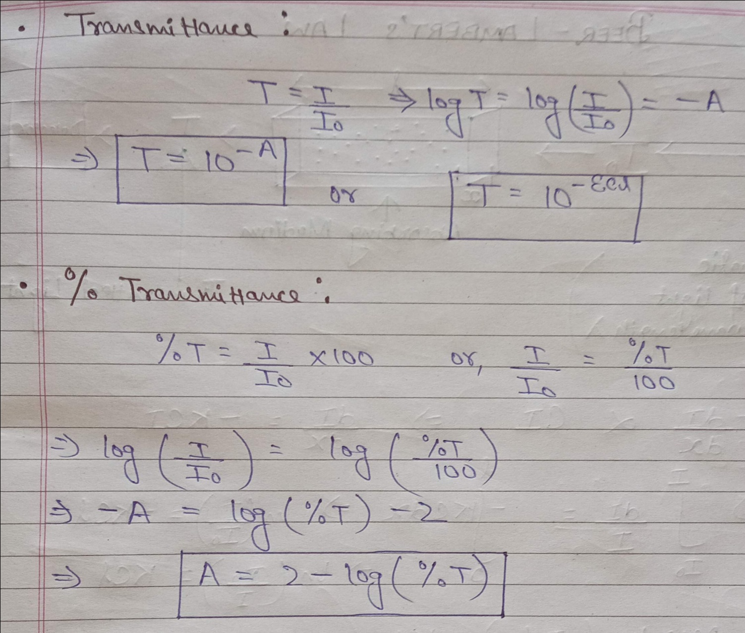
Continued….

Slide 7
Operating Principle
When infrared radiation interacts with gas molecules, infrared light is absorbed by the gas molecules at a particular wavelength, causing vibration of the gas molecules. NDIR gas sensors detects the decrease in transmitted infrared light which is in proportion to gas concentration. This transmittance, the ratio of transmitted radiation energy to the incident energy, is dependent on target gas concentration.

Slide 8
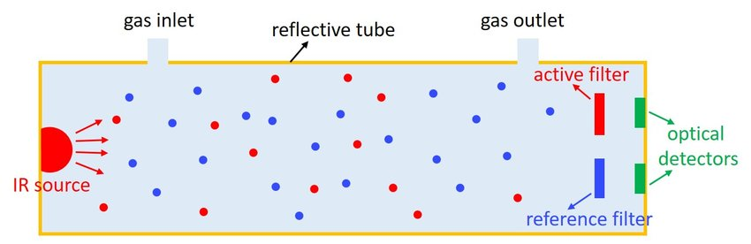
Continued….
NDIR gas sensor consist of an infrared source, detector, optical filter, gas cell, and electronics for signal processing. A single light source, dual wavelength type gas sensor has two detectors and two optical filters of different wavelengths which are placed in front of each detector. Infrared light that is absorbed by a target gas passes through the active filter with a particular bandwidth for the detection of the target gas. Infrared light that does not interact with the target gas passes through the reference filter. The difference between transmitted light intensities in these two bandwidths is converted into gas concentration.

Slide 9
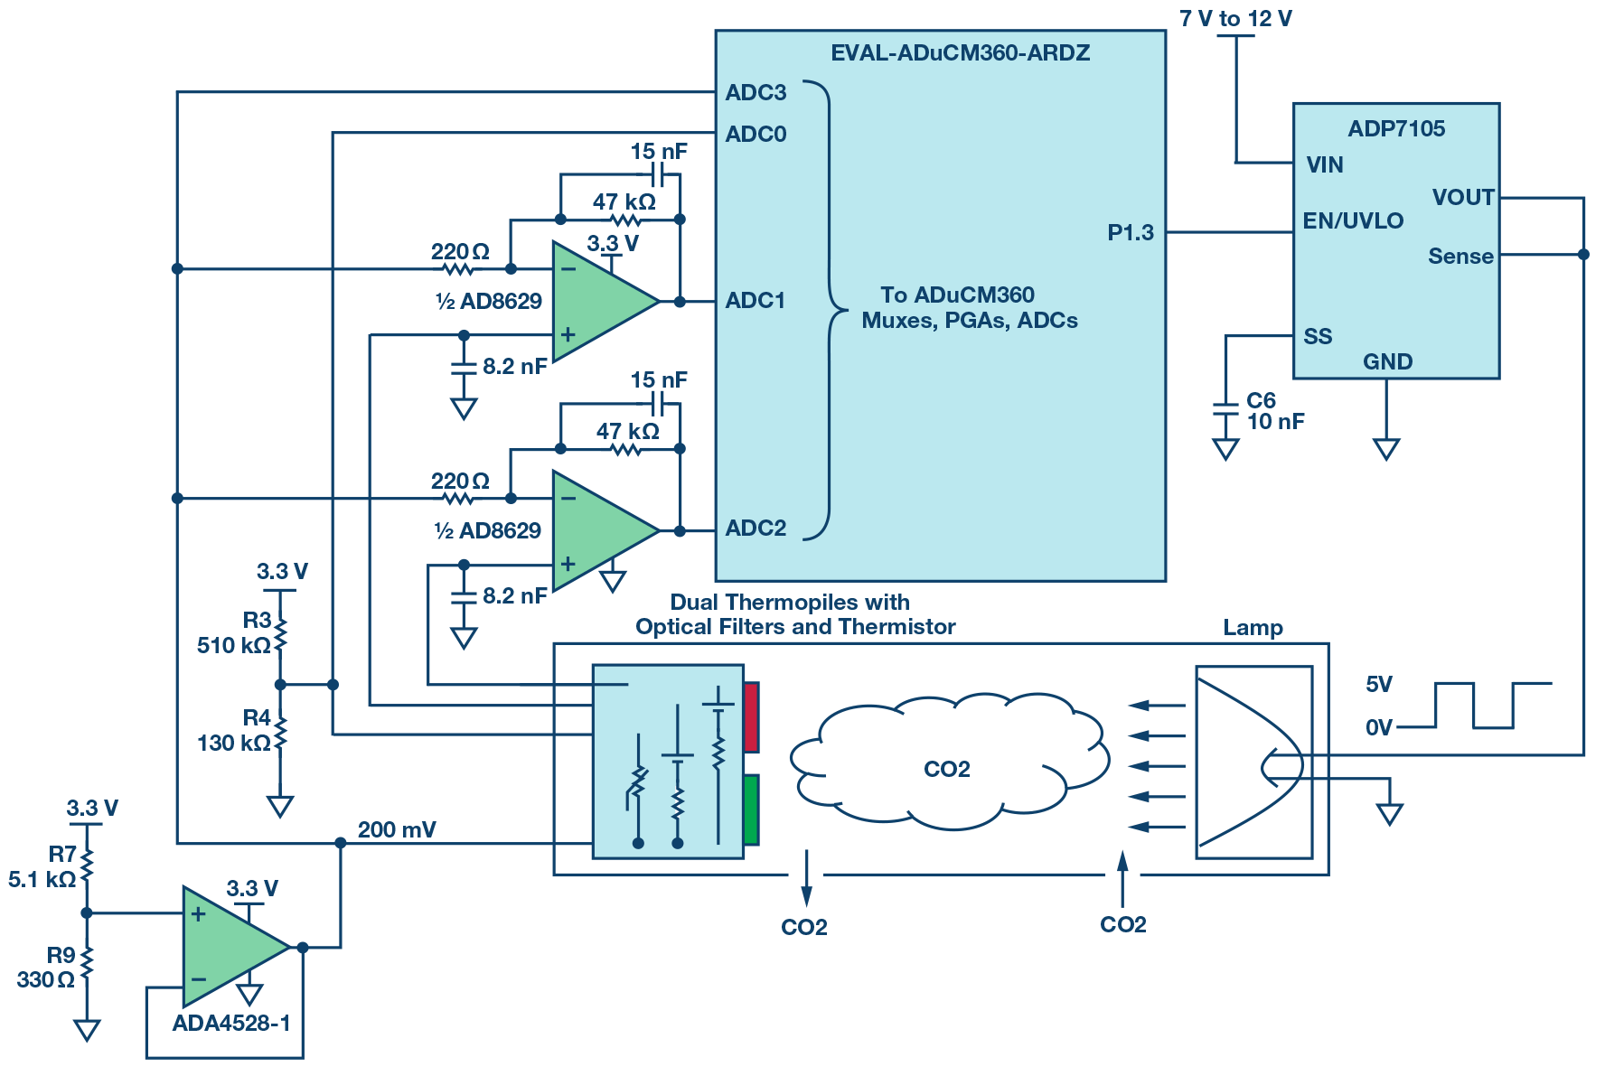
NDIR Gas Sensing Circuit

Slide 10
References….
https://www.co2meter.com/
https://en.gassensor.com.cn/
https://www.analog.com/
https://www.researchgate.net/

Slide 11


